Slide 1

Introduction to Machine Learning Topic 0 – Course Introduction
Master in Quantitative Economic Analysis MQuEA
Javier Bas
Universidad Autónoma de Madrid
2022/2023

Slide 2
Outline
Me
What this course is and what is not
References
Syllabus
Tools
Assessment
Master´s thesis
Master in Quantitative Economic Analysis MQuEA
Universidad Autónoma de Madrid

Slide 3


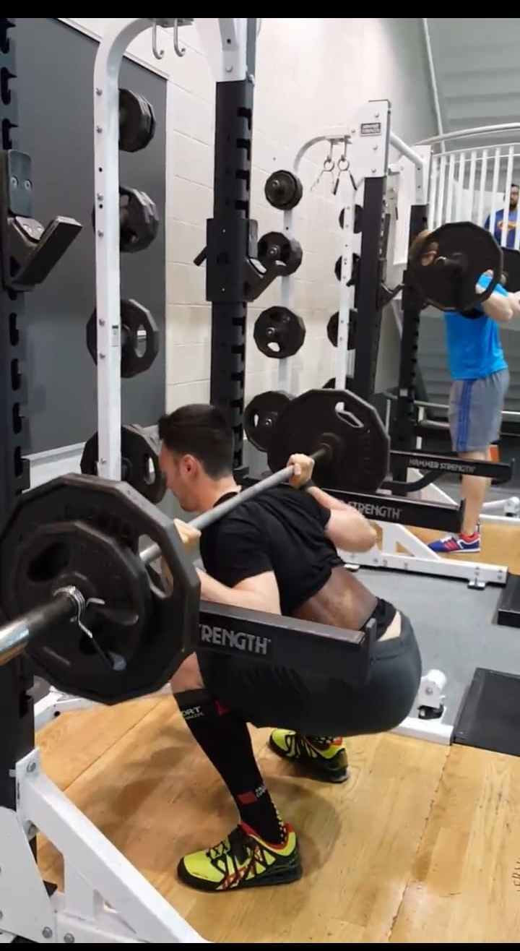




Me
Master in Quantitative Economic Analysis MQuEA
Universidad Autónoma de Madrid

Slide 4
What this course is and what it is not
What it is…
A theoretical and practical introduction to Machine Learning methods
A lab
A safe environment to make mistakes
A place to discuss, share and have fun while learning
What it is not…
A coding course
Master in Quantitative Economic Analysis MQuEA
Universidad Autónoma de Madrid

Slide 5
What this course is and what it is not
What it is…
A theoretical and practical introduction to Machine Learning methods
A lab
A safe environment to make mistakes
A place to discuss, share and have fun while learning
What it is not…
A coding course
Master in Quantitative Economic Analysis MQuEA
Universidad Autónoma de Madrid

Slide 6
References
James, G., Witten, D., Hastie, T., & Tibshirani, R. (2013). An introduction to statistical learning (Vol. 112, p. 18). New York: springer.
Géron, A. (2019). Hands-on machine learning with Scikit-Learn, Keras, and TensorFlow: Concepts, tools, and techniques to build intelligent systems. " O'Reilly Media, Inc.".
Müller, A. C., & Guido, S. (2016). Introduction to machine learning with Python: a guide for data scientists. " O'Reilly Media, Inc.".
VanderPlas, J. (2016). Python data science handbook: Essential tools for working with data. " O'Reilly Media, Inc.".
Master in Quantitative Economic Analysis MQuEA
Universidad Autónoma de Madrid

Slide 7
Syllabus
Topic 0 – Introduction to course
Part I - Basic stuff (~1 week)
Topic 1 – What is Machine Learning? (HO Ch. 1 / ISL Ch. 2)
Topic 2 – A Machine Learning Project (HO Ch. 2 / ISL Ch. 2)
Topic 3 – Resampling methods (ISL Ch. 5)
Part II - Supervised Learning (~4 weeks)
Topic 4 – Classification (HO Ch. 3, ISL Ch. 4)
Topic 5 – Tree-based Methods (HO Ch. 6 & 7)
Topic 6 – Neural Networks (HO Ch. 10) ??
HW #1
HW #2
Master in Quantitative Economic Analysis MQuEA
Universidad Autónoma de Madrid

Slide 8
Syllabus
Part III - Unsupervised Learning (~3 weeks)
Topic 7 – Dimensionality Reduction (HO Ch. 8 / ISL Ch. 10 / IMLP Ch. 3)
Topic 8 – Clustering (HO Ch.9, ISL Ch. 10)
Advanced topics (2 days)
Deep Computer Vision Using Convolutional Neural Networks?
Natural Language Processing?
HW #3
Special guests!
Master in Quantitative Economic Analysis MQuEA
Universidad Autónoma de Madrid

Slide 9
Tools
Google Colab (https://colab.research.google.com)
IDEs (Visual Studio Code, Spyder, PyCharm, RStudio (Posit))
GitHub
Moodle
Master in Quantitative Economic Analysis MQuEA
Universidad Autónoma de Madrid

Slide 10
Assessment
Assignments, “groups” of 1-2 students: 40%
Final exam: 60%
Voluntary additional work: Bonus up to 10%, additional to the final grade (if > 5)
Master in Quantitative Economic Analysis MQuEA
Universidad Autónoma de Madrid

Slide 11
Master’s thesis
I’m open to supervise master’s thesis (within my capabilities in terms of # of students) on ML topics.
I’m interested I the following topics, but feel free to propose your own research ideas:
Prediction of financial assets’ price
The role of ethics in ML
Any advanced application of ML methods
I am a demanding advisor.
Master in Quantitative Economic Analysis MQuEA
Universidad Autónoma de Madrid

